Slide 1


Slide 2
Objective
The major aim of this project is to gain insight into the sales data of Amazon to understand the different factors that affect sales of the different branches.

Slide 3
About Data:
This dataset contains sales transactions from three different branches of Amazon, respectively located in Mandalay, Yangon and Naypyitaw. The data contains 17 columns and 1000 rows:

Slide 4
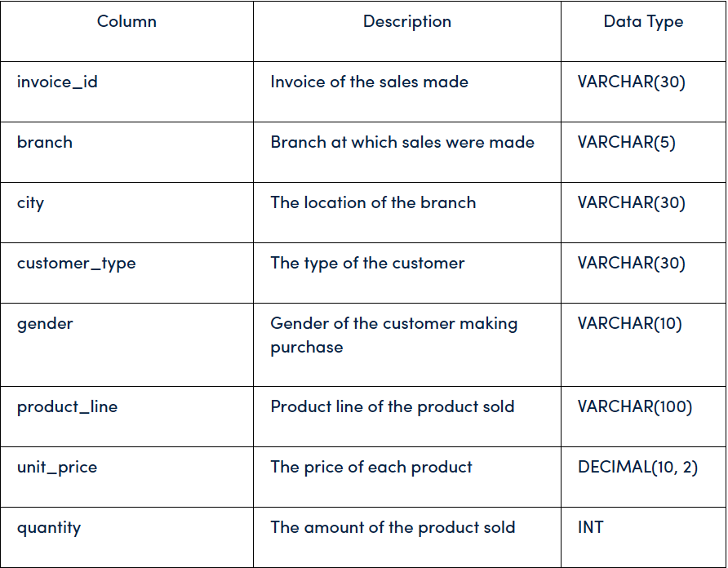

Slide 5
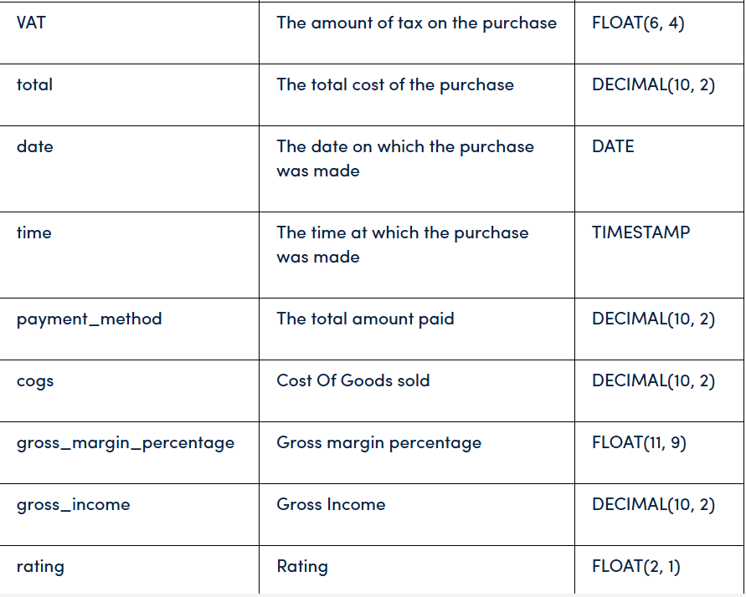

Slide 6
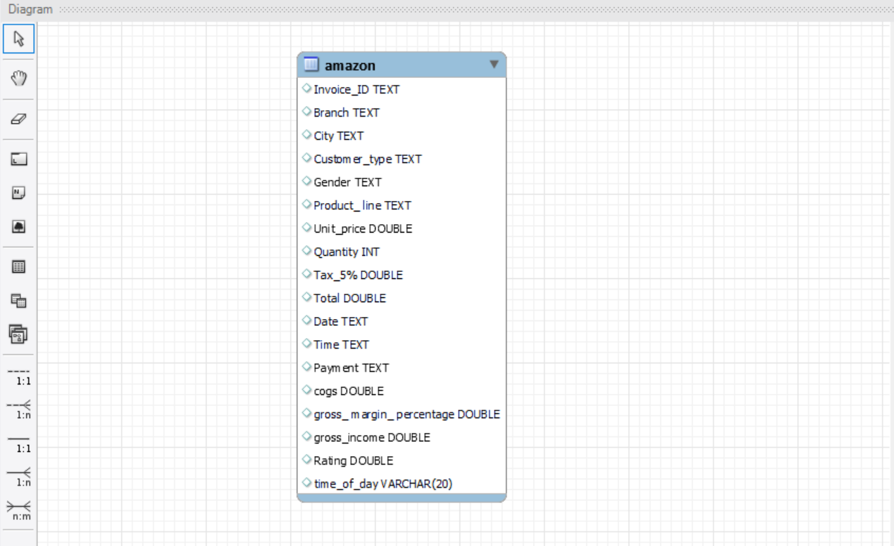

Slide 7
1) Product Analysis :-
Conduct analysis on the data to understand the different product lines, the products lines performing best and the product lines that need to be improved.

Slide 8
2)Sales Analysis :-
This analysis aims to answer the question of the sales trends of product. The result of this can help us measure the effectiveness of each sales strategy the business applies and what modifications are needed to gain more sales.

Slide 9
3) Customer Analysis :-
This analysis aims to uncover the different customer segments, purchase trends and the profitability of each customer segment.

Slide 10
Approach Used :-
1) Data Wrangling: This is the first step where inspection of data is done to make sure NULL values and missing values are detected and data replacement methods are used to replace missing or NULL values.

Slide 11
1.1 Build a database

Slide 12
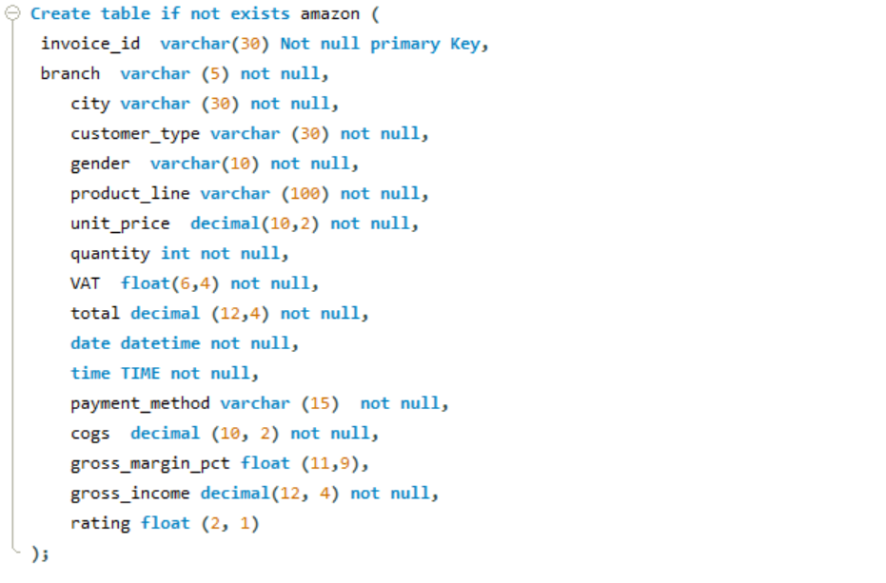
1.2 Create a table and insert the data.

Slide 13
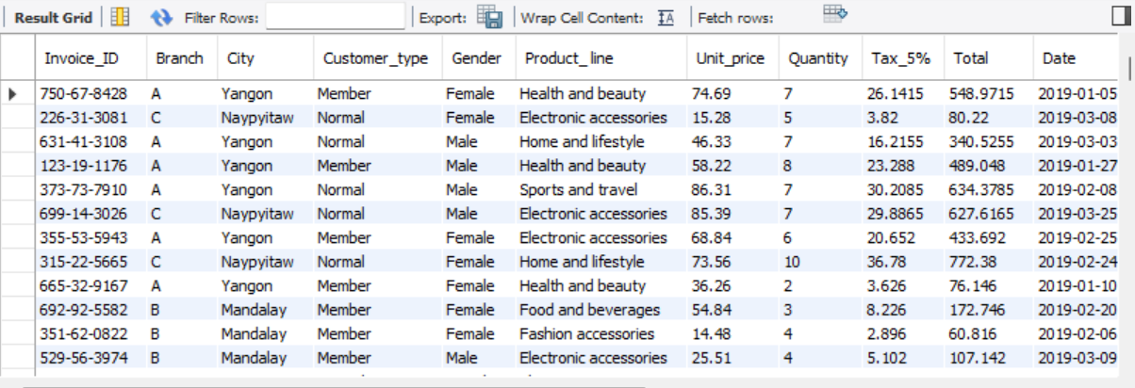
Import Data from CSV
After creating a database, import data from a CSV file.

Slide 14
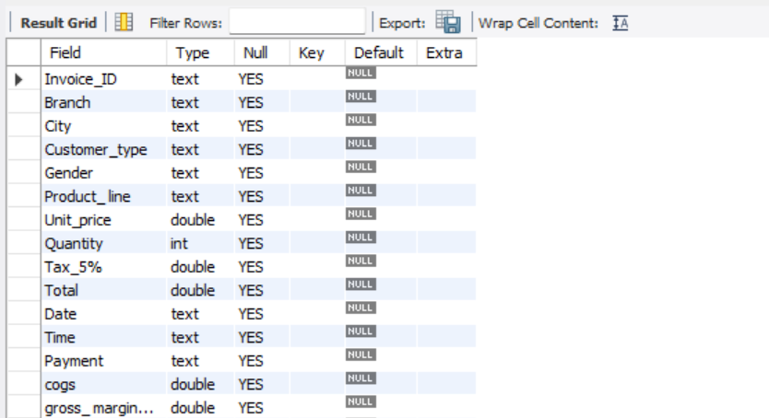
1.3 Select columns with null values in them. There are no null values in our database as in creating the tables, we set NOT NULL for each field, hence null values are filtered out.

Slide 15
2) Feature Engineering: This will help us generate some new columns from existing ones.
2.1 Add a new column named time_of_day to give insight of sales in the Morning, Afternoon and Evening. This will help answer the question on which part of the day most sales are made.

Slide 16
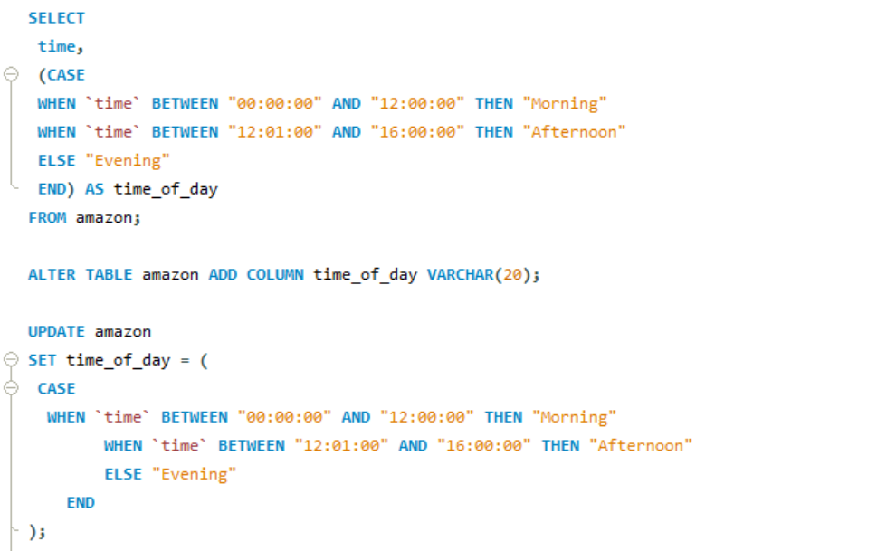
Query :-

Slide 17
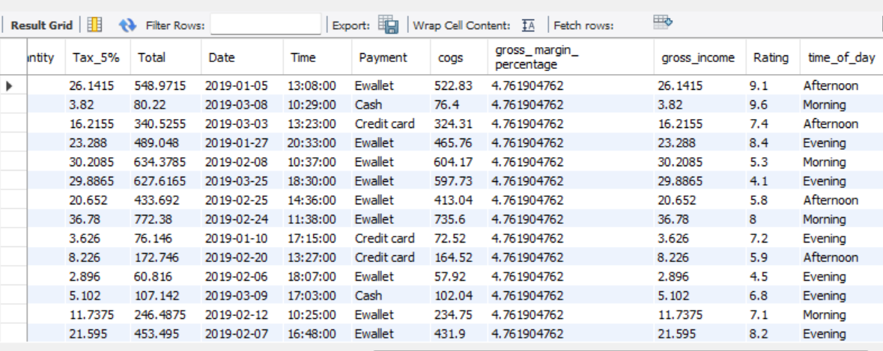
Output :-

Slide 18
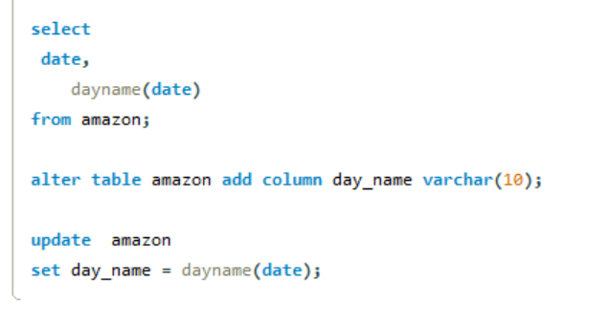
2.2 Add a new column named dayname that contains the extracted days of the week on which the given transaction took place (Mon, Tue, Wed, Thur, Fri). This will help answer the question on which week of the day each branch is busiest.
QUERY :-

Slide 19
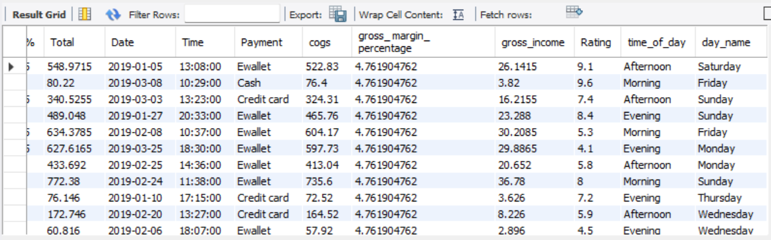
OUTPUT :-

Slide 20
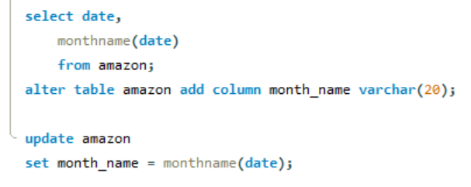
2.3 Add a new column named monthname that contains the extracted months of the year on which the given transaction took place (Jan, Feb, Mar). Help determine which month of the year has the most sales and profit.
QUERY :-

Slide 21
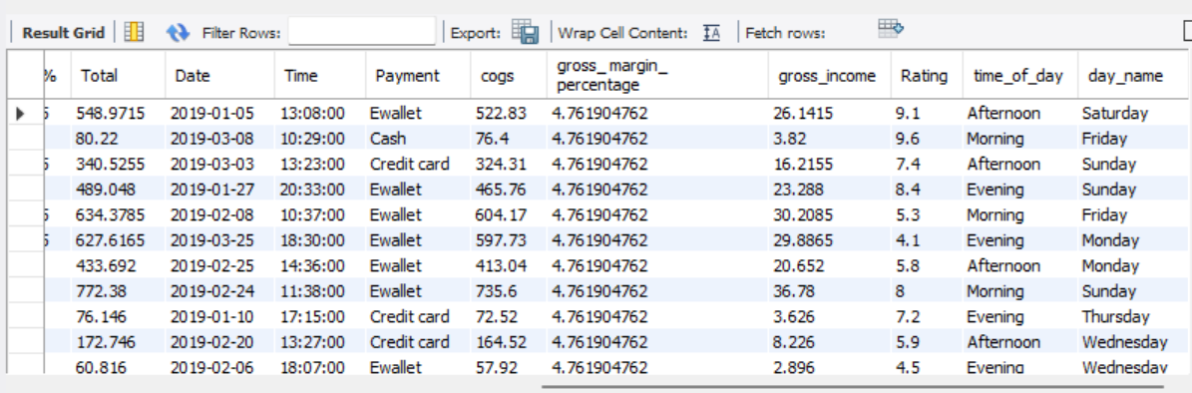
OUTPUT :-

Slide 22
3. Exploratory Data Analysis (EDA): Exploratory data analysis is done to answer the listed questions and aims of this project.
Business Questions To Answer :-

Slide 23

1) What is the count of distinct cities in the dataset?
QUERY :-
OUTPUT :-

Slide 24
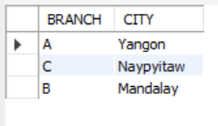
2) For each branch, what is the corresponding city?
QUERY :-
OUTPUT :-

Slide 25


3) What is the count of distinct product lines in the dataset?
QUERY :-
OUTPUT :-

Slide 26
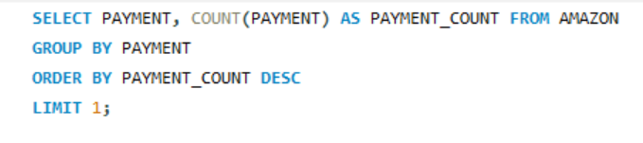

4)Which payment method occurs most frequently?
QUERY :-
OUTPUT :-

Slide 27
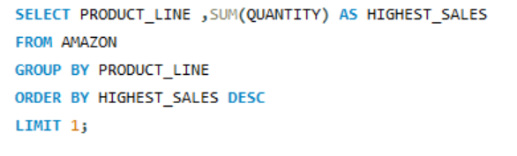

5) Which product line has the highest sales?
QUERY :-
OUTPUT :-

Slide 28
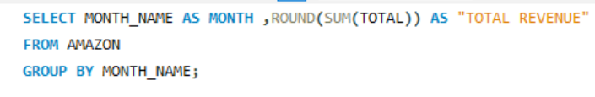
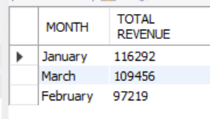
6) How much revenue is generated each month?
QUERY :-
OUTPUT :-

Slide 29
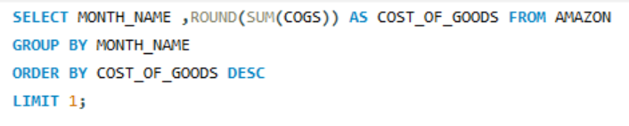

7) In which month did the cost of goods sold reach its peak?
QUERY :-
OUTPUT :-

Slide 30
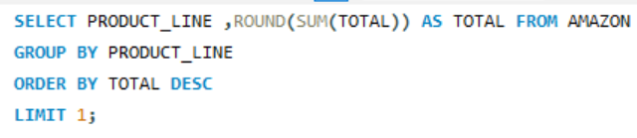

8) Which product line generated the highest revenue?
QUERY :-
OUTPUT :-

Slide 31
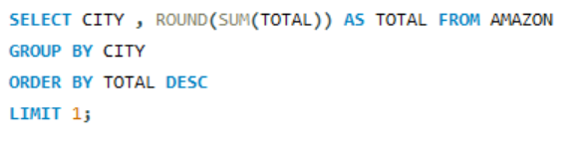

9) In which city was the highest revenue recorded?
QUERY :-
OUTPUT :-

Slide 32
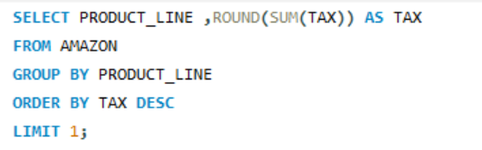

10) Which product line incurred the highest Value Added Tax?
QUERY :-
OUTPUT :-

Slide 33
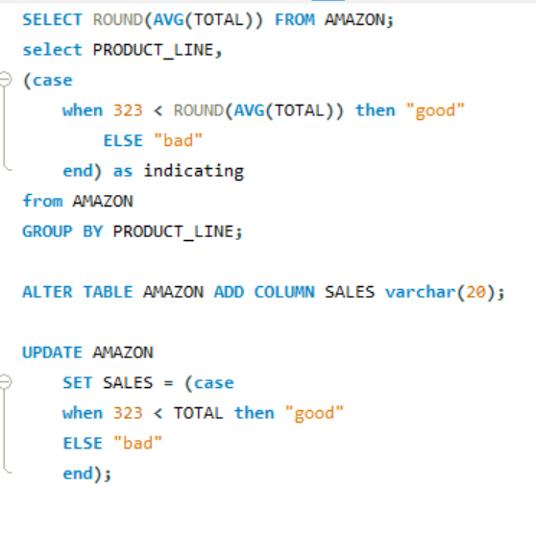
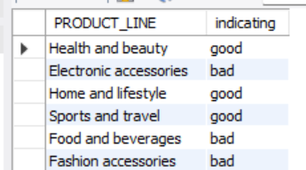
11) For each product line, add a column indicating "Good" if its sales are above average, otherwise "Bad."
QUERY :-
OUTPUT :-

Slide 34
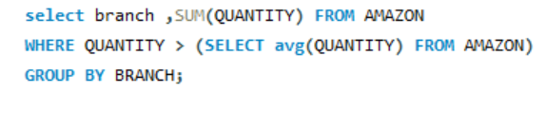
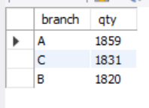
12) Identify the branch that exceeded the average number of products sold.
QUERY :-
OUTPUT :-

Slide 35
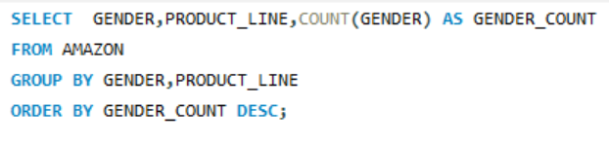
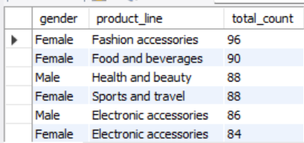
13) Which product line is most frequently associated with each gender?
QUERY :-
OUTPUT :-

Slide 36
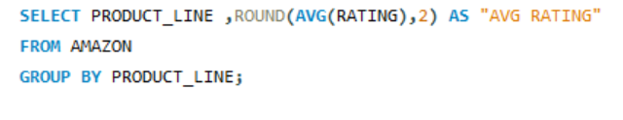
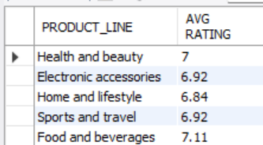
14) Calculate the average rating for each product line.
QUERY :-
OUTPUT :-

Slide 37
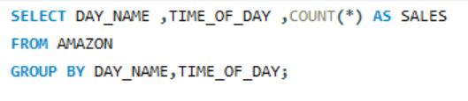
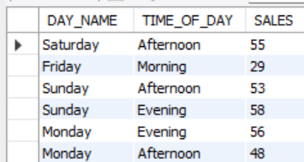
15) Count the sales occurrences for each time of day on every weekday.
QUERY :-
OUTPUT :-

Slide 38
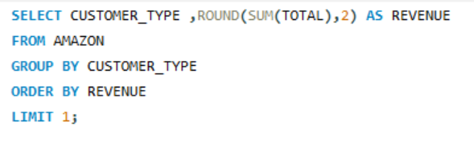

16) Identify the customer type contributing the highest revenue.
QUERY :-
OUTPUT :-

Slide 39
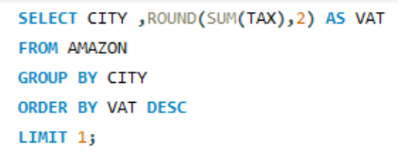

17) Determine the city with the highest VAT percentage.
QUERY :-
OUTPUT :-

Slide 40
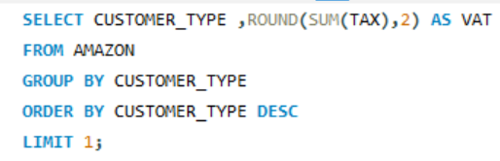

18) Identify the customer type with the highest VAT payments.
QUERY :-
OUTPUT :-

Slide 41
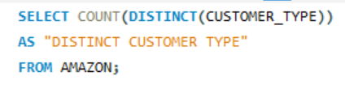
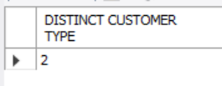
19) What is the count of distinct customer types in the dataset?
QUERY :-
OUTPUT :-

Slide 42
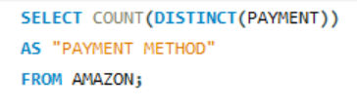

20) What is the count of distinct payment methods in the dataset?
QUERY :-
OUTPUT :-

Slide 43
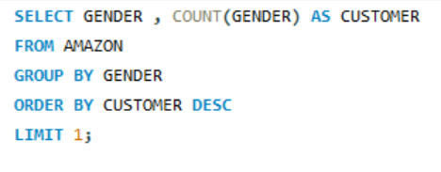

21) Which customer type occurs most frequently?
QUERY :-
OUTPUT :-

Slide 44
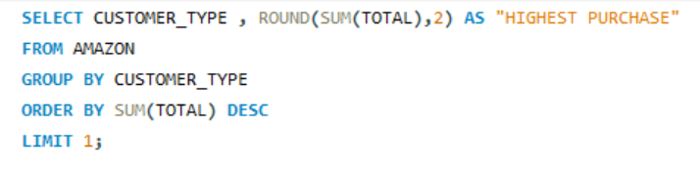

22) Identify the customer type with the highest purchase frequency.
QUERY :-
OUTPUT :-

Slide 45
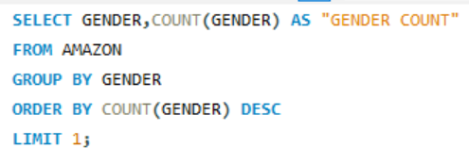

23) Determine the predominant gender among customers.
QUERY :-
OUTPUT :-

Slide 46
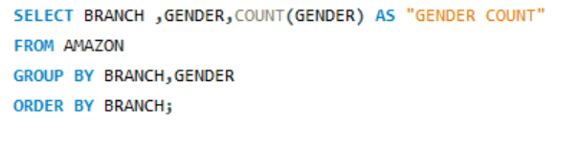
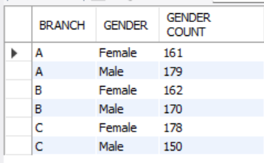
24) Examine the distribution of genders within each branch.
QUERY :-
OUTPUT :-

Slide 47
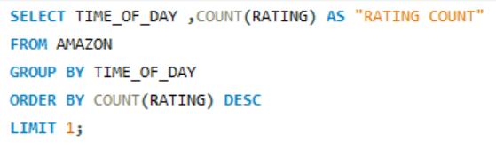
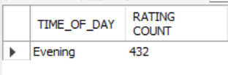
25) Identify the time of day when customers provide the most ratings.
QUERY :-
OUTPUT :-

Slide 48
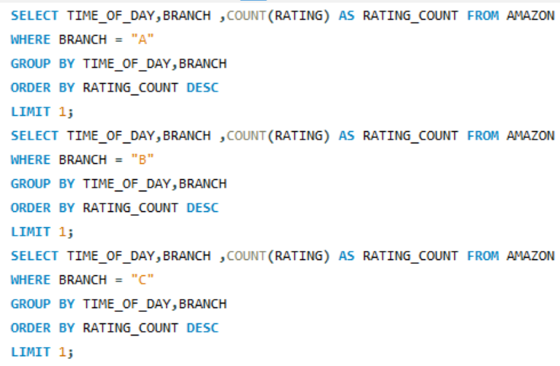



26) Determine the time of day with the highest customer ratings for each branch.
QUERY :-
OUTPUT :-

Slide 49
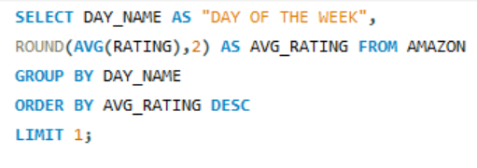

27) Identify the day of the week with the highest average ratings.
QUERY :-
OUTPUT :-

Slide 50
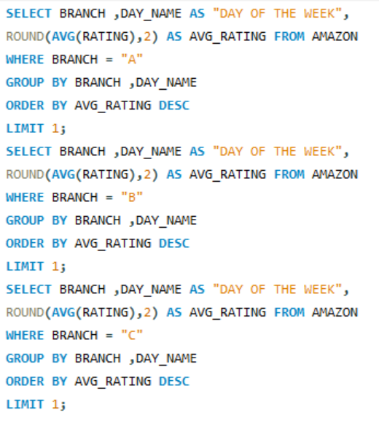
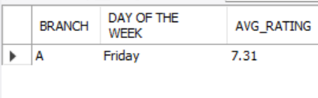


28) Determine the day of the week with the highest average ratings for each branch.
QUERY :-
OUTPUT :-

Slide 51
THANK YOU
SURYAKANT RANJAN

